Slide 1


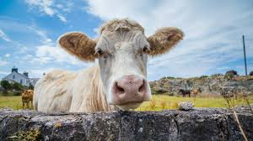
Practical meat hygiene
Stage: 5th
Ante mortem inspection
By
Sara S. Mohammed
Department of Veterinary Public Health
College of veterinary medicine
university of basrah

Slide 2
What is Meat Hygiene?
Meat: is the common term used to describe the edible portion of animal tissues.
Hygiene: (which comes from the name of the Greek goddess of health, Hygieia), is a set of practices performed for the preservation of Health
Meat hygiene make sure that meat is safe, and that its production and processing satisfies hygiene laws.

Slide 3
Meat inspection
The objectives of meat inspection programme are:
1-animals are slaughtered for human consumption and that abnormal animals are separated and dealt with accordingly.
2-To ensure that meat from animals is free from disease, wholesome and of no risk to human health.
3-Safe from harmful chemical and drug residues, and capable of being converted into wholesome product for the consumer.
4-Notifiable diseases may be detected at ante mortem inspection ( e.g. Anthrax ,FMD. TB, Brucellosis….cet.)

Slide 4
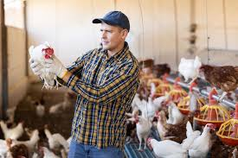
These objectives are achieved by:
1-Antemortem Inspection.
2-Postmortem inspection procedures.
3-Hygienic dressing with minimum contamination.
4-Whenever appropriate the Hazard Analysis Critical Control Point (HACCP) principles should be used

Slide 5
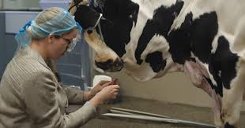
The term ante-mortem means “before death.”
Ante-mortem inspection is the inspection of live animals before they are slaughtered.
In any abattoir, all livestock presented for slaughter must receive ante-mortem inspection.

Slide 6
Ante-mortem inspection of live animals is a screening process :
1- to remove obviously diseased animals from the food supply prior to slaughter .
2-to identify animals that require a more extensive postmortem examination.
*It is the first line of defense in protecting the public from potentially harmful meat products.
*Those animals that exhibit abnormal signs must be withheld from normal slaughter and segregated for closer examination.

Slide 7

What is the meaning of ante mortem inspection?

Slide 8
The major objectives of ante mortem inspection are as follows:
1-to screen all animals destined to slaughter.
2-to ensure that animals are properly rested and that proper clinical information, which will assist in the disease diagnosis and judgment, is obtained.
3-to reduce contamination on the killing floor by separating the dirty animals and condemning the diseased animals if required by regulation.
4-to ensure that injured animals or those with pain and suffering receive emergency slaughter and that animals are treated humanely

Slide 9
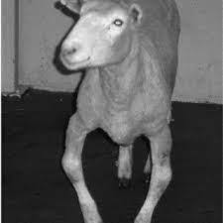
5-to identify reportable animal diseases to prevent killing floor contamination.
6-to identify sick animals and those treated with antibiotics, chemotherapeutic agents, insecticides and pesticides.
7-to require and ensure the cleaning and disinfection of trucks used to transport livestock.

Slide 10
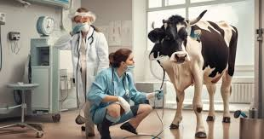
*Both sides of an animal should be examined at rest and in motion.
*Ante mortem examination should be done within 24 hours of slaughter and repeated if slaughter has been delayed over a day.

Slide 11
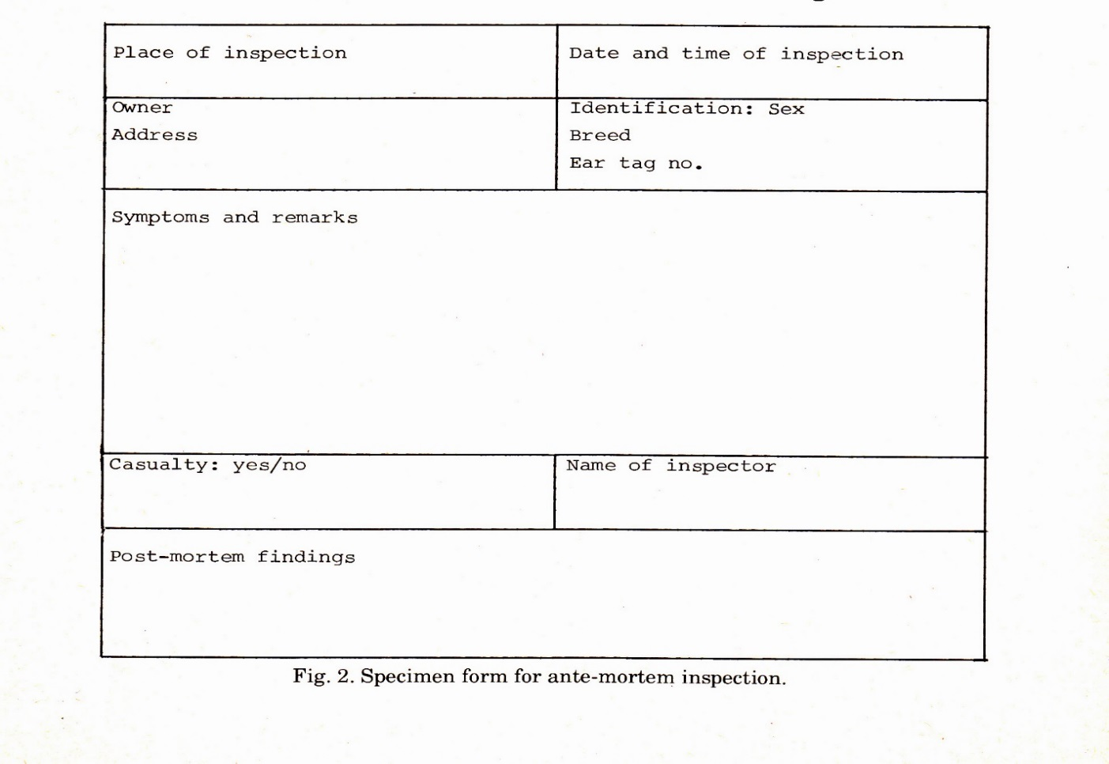
A/M Inspection Card

Slide 12
Ante-mortem inspection methodology:
The disease and management history should be recorded and reported on an A/M inspection card. Other information should include:
1.Owner's name
2.The number of animals in the lot and arrival time
3.Species and sex of the animal
4.The time and date of ante mortem inspection
5.Clinical signs and body temperature if relevant
6.Reason why the animal was held
7.Signature of inspector

Slide 13
Some of the abnormalities which are checked on antemortem examination include:
1.Abnormalities in respiration
2.Abnormalities in behaviour
3.Abnormalities in gait
4.Abnormalities in posture
5.Abnormalities in structure and conformation
6.Abnormal discharges or protrusions from body openings
7.Abnormal colour
8.Abnormal odour

Slide 14
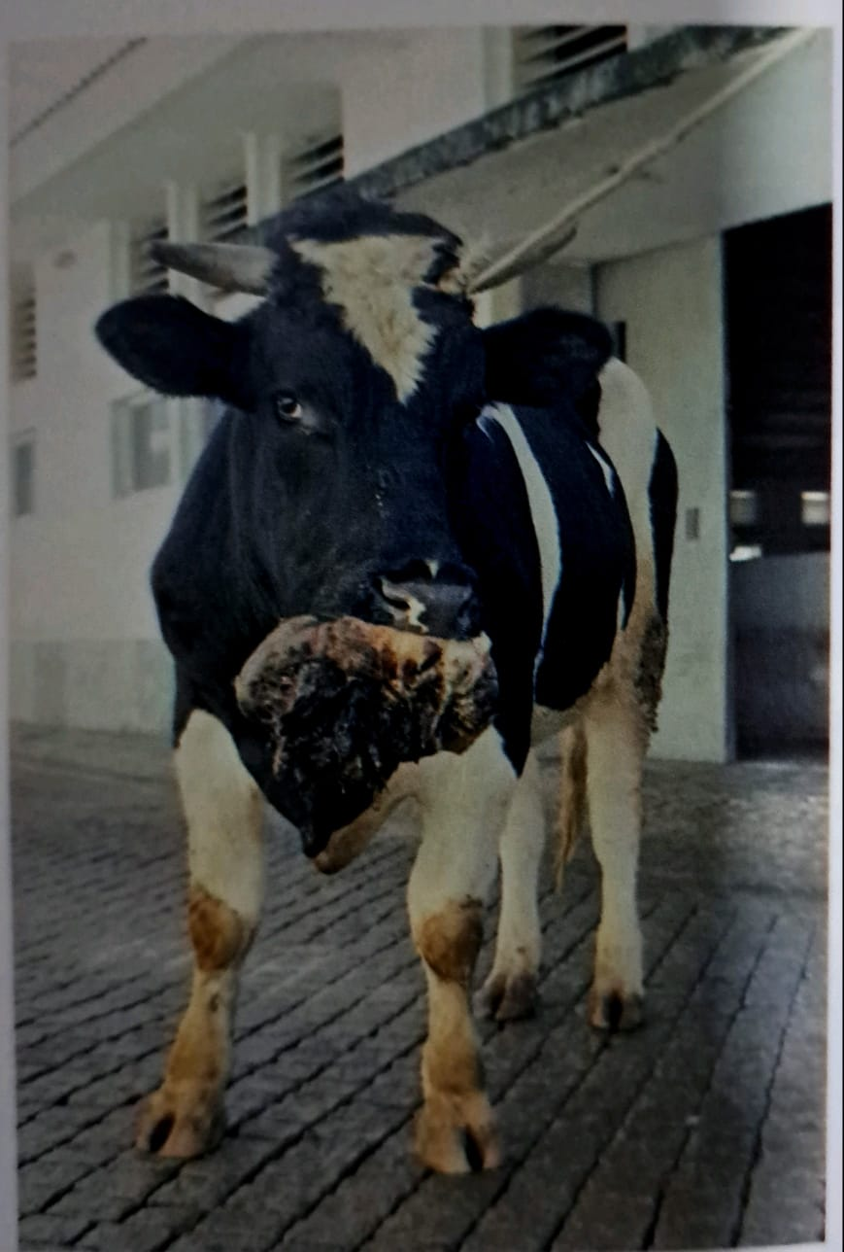
Some examples:
Basal cell carcinoma -lower lip: ox
The lower lip was totally replaced by a very large, cauliflower-like neoplasia, with firm consistency and areas of congestion and haemorrhage.
Decision: Condemnation at the ante-mortem inspection

Slide 15
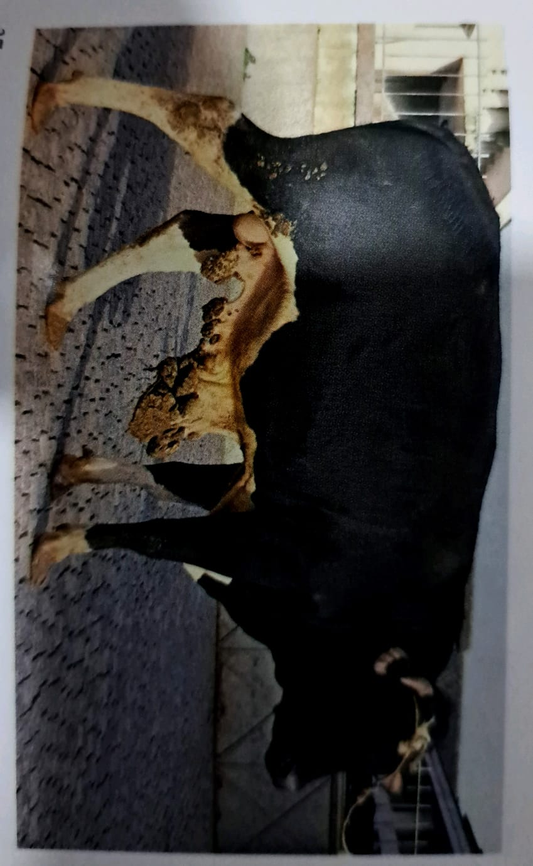
Papillomatosis-prepuce: ox
Multiple tumors, consistent and with cauliflower appearance were distributed along the prepuce.
Decision: Slaughter authorized under special precautions. The tissue removed for histopathological examination should be collected both from the base of the tumor and from its surface.

Slide 16
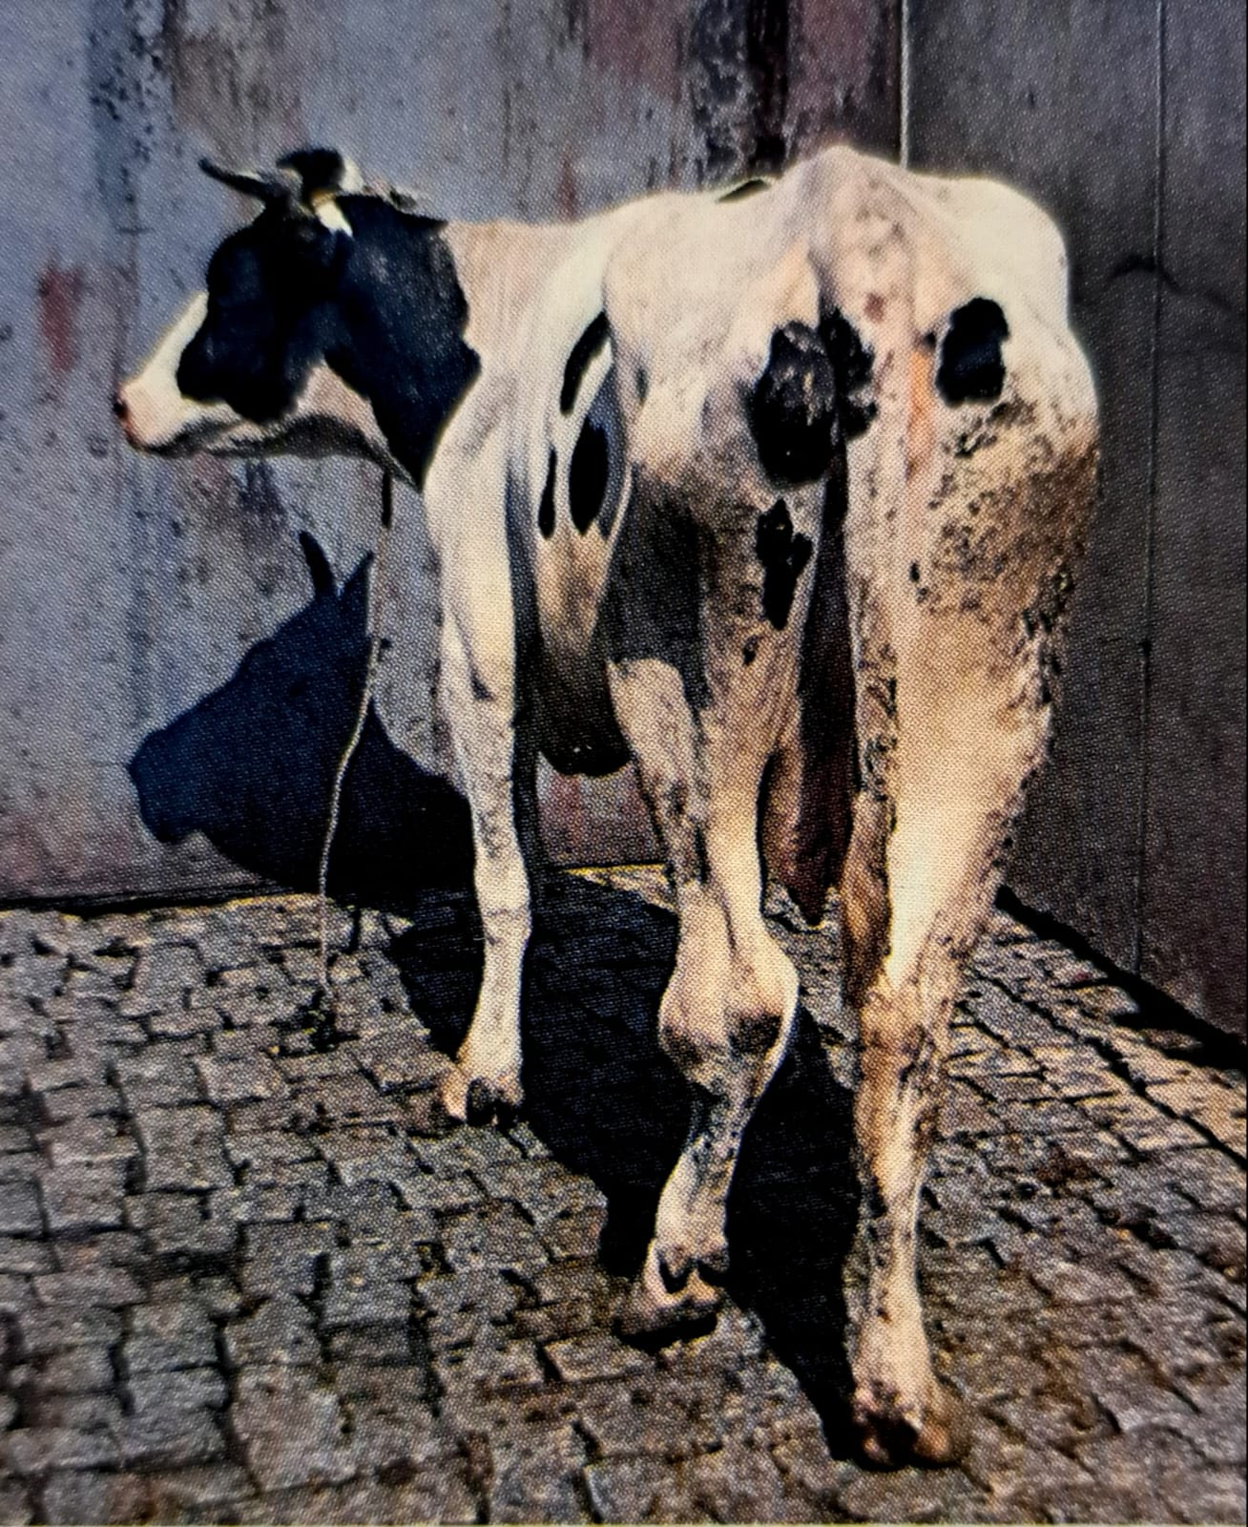
Arthritis-hock joint: cow
The animal avoided standing on the left pelvic limb due to an inflammatory reaction of the hook joint. The muscles of the affected limb were considerably atrophic, in contrast to the right one.
Decision: Slaughter authorized under special precautions

Slide 17
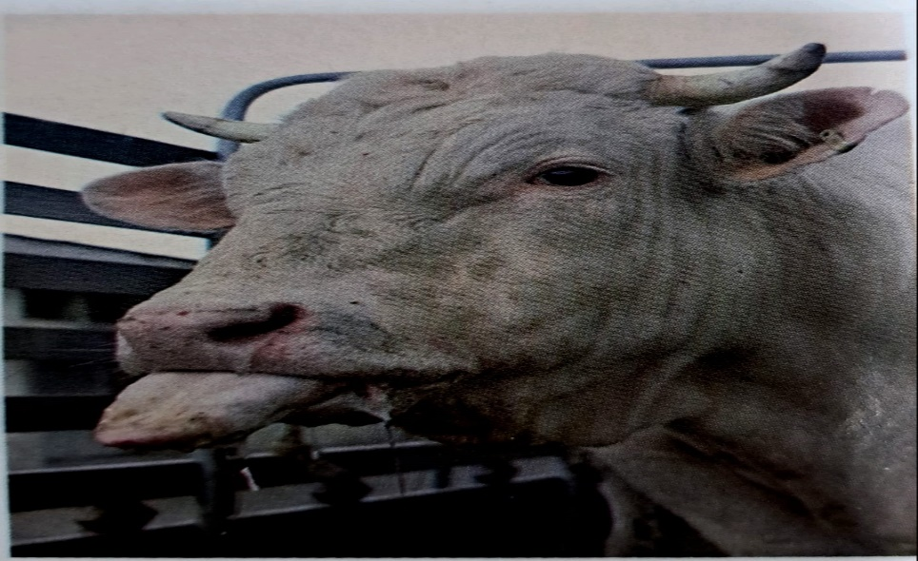
Foot and mouth disease: ox
This animal was condemned at the ante-mortem inspection because of hyperthermia, sialorrhea (viscous saliva) and persistent protrusion of the tongue

Slide 18
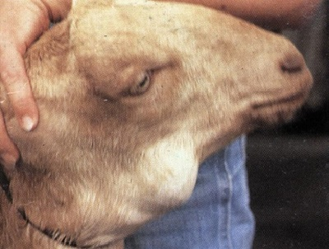
(ACTIVTIES) What do you see and what is the disease?

Slide 19
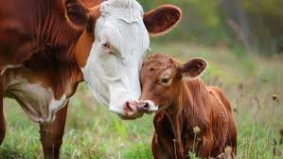
                Thank you for listening

